Slide 1
INTRODUCTION TO BIGDATA WITH HADOOP BY B KEERTHI SAMHITHA

Slide 2
OVERVIEW
BIG DATA
HADOOP
HISTORY
HADOOP ECOSYSTEM
*HDFS
*MAPREDUCE
HIVE, PIG, SQOOP, FLUME, HBASE, ZOOKEEPER,
OOZIE, YARN, SPARK, CASSENDRA.
CASE STUDY
CONCLUSION

Slide 3

BIGDATA

Slide 4
BIGDATA
Big data means really a big data, it is a collection of large datasets that cannot be processed using traditional computing techniques.
Big data is not merely a data, rather it has become a complete subject, which involves various tools, techniques and frameworks.
Big data involves the data produced by different devices and applications.
Black Box Data, Social Media Data ,Stock Exchange Data , Power Grid Data , Transport Data, Search Engine Data.

Slide 5
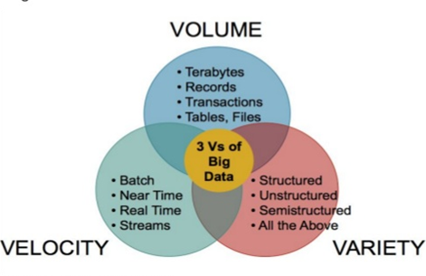
BIGDATA CHALLENGES

Slide 6
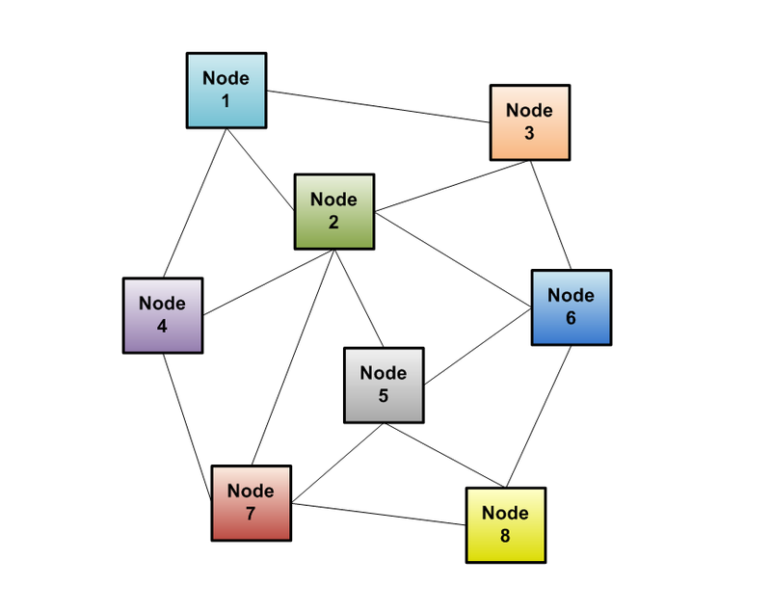
SOLUTION – DISTRIBUTED SYSTEM

Slide 7
DISTRIBUTED SYSTEM - APPROACH
A new approach of the distributed system is called as Hadoop
HADOOP
- A scalable fault-tolerant distributed system for data storage and processing
Distribute data when the data is stored
Process data where the data is
Data is replicated

Slide 8

HADOOP
Apache Hadoop is an open-source software framework for storage and large-scale processing of data-sets on clusters of commodity hardware.
Some of the characteristics:
Open source
Distributed processing
Distributed storage
Scalable
Reliable
Fault-tolerant
Economical
Flexible

Slide 9
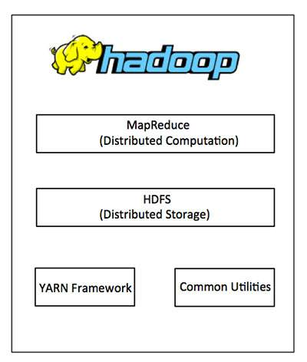
ARCHITECTURE OH HADOOP

Slide 10
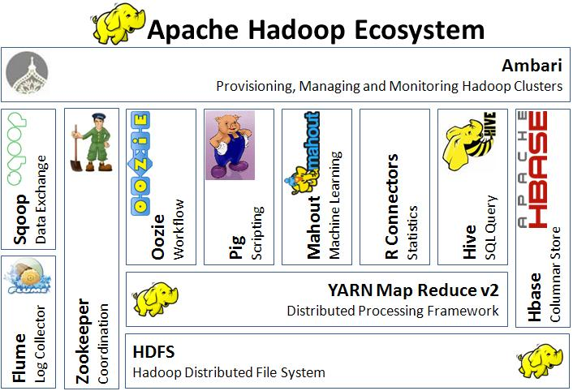
HADOOP ECOSYSTEM

Slide 11
HADOOP COMPONENTS
HDFS
MAPREDUCE
HIVE
PIG
SQOOP
FLUME
HBASE
OOZIE
ZOOKEEPER
YARN
SPARK
CASSENDRA

Slide 12
HDFS
A distributed file system that provides high-throughput access to application data.
It is suitable for the distributed storage and processing.
Hadoop provides a command interface to interact with HDFS.
The built-in servers of namenode and datanode help users to easily check the status of cluster.
Streaming access to file system data.
HDFS provides file permissions and authentication

Slide 13
HDFS GOALS
Fault detection and recovery
Huge datasets
Hardware at data

Slide 14
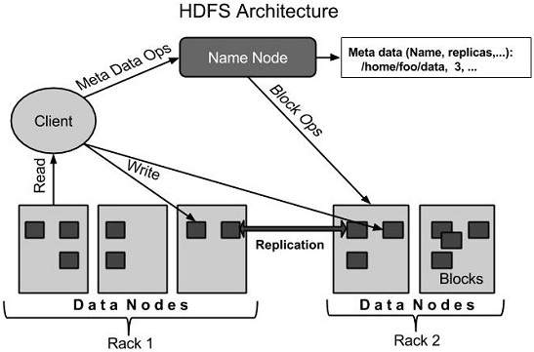
HADOOP ARCHITECTURE

Slide 15
NODES
NameNode:
Master of the system
Maintains and manages the blocks which are present on the DataNodes
DataNodes:
Slaves which are deployed on each machine and provide the actual storage
Responsible for serving read and write requests for the clients
Jobtracker:
takes care of all the job scheduling and assign tasks to Task Trackers.
TaskTracker:
a node in the cluster that accepts tasks - Map, Reduce and Shuffle operations - from a jobtracker

Slide 16
NameNode:
Stores metadata for the files, like the directory structure of a typical FS.
The server holding the NameNode instance is quite crucial, as there is only one.
Transaction log for file deletes/adds, etc. Does not use transactions for whole blocks or file-streams, only metadata.
Handles creation of more replica blocks when necessary after a DataNode failure

Slide 17
DataNode:
Stores the actual data in HDFS
Can run on any underlying filesystem (ext3/4, NTFS, etc)
Notifies NameNode of what blocks it has
NameNode replicates blocks 2x in local rack, 1x elsewhere

Slide 18
MAPREDUCE
The Mapper:
Each block is processed in isolation by a map task called mapper
Map task runs on the node where the block is stored
The Reducer:
Consolidate result from different mappers
Produce final output
----------- Also,
The Map Task:
This is the first task, which takes input data and converts it into a set of data, where individual elements are broken down into tuples (key/value pairs).
The Reduce Task:
This task takes the output from a map task as input and combines those data tuples into a smaller set of tuples. The reduce task is always performed after the map task.

Slide 19
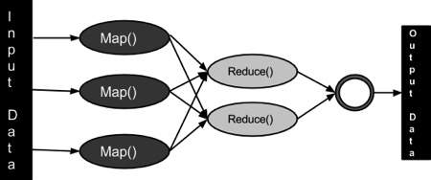
MapReduce ARCHITECTURE

Slide 20
MapReduce Engine:
JobTracker & TaskTracker
JobTracker splits up data into smaller tasks(“Map”) and sends it to the TaskTracker process in each node
TaskTracker reports back to the JobTracker node and reports on job progress, sends data (“Reduce”) or requests new jobs

Slide 21
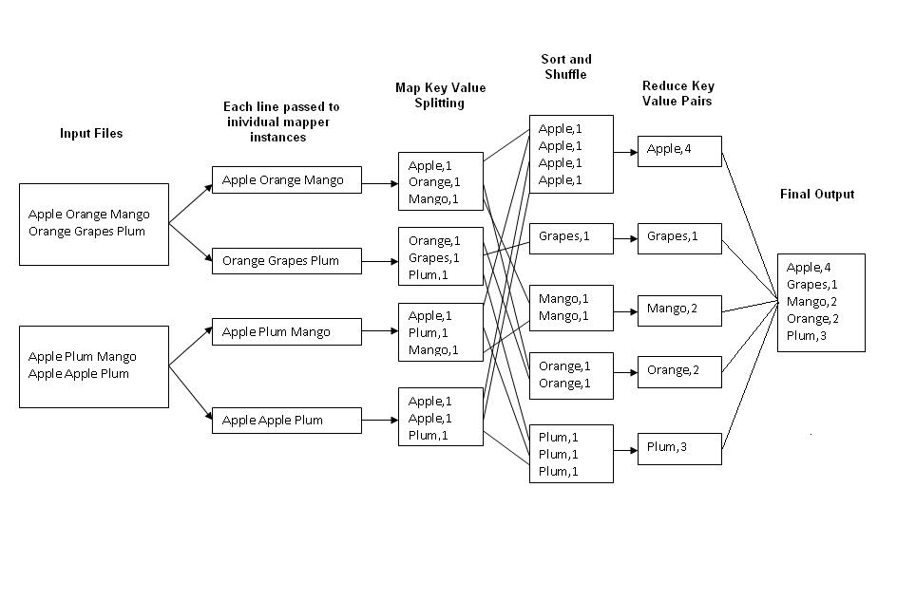
EXAMPLE : WORD COUNT

Slide 22
DISADVANTAGES OF MR
Failures are norm in commodity hardware
Worker failure
Detect failure via periodic heartbeats
Re-execute in-progress map/reduce tasks
Master failure
Single point of failure; Resume from Execution Log
Robust
Google’s experience: lost 1600 of 1800 machines once!, but finished fine

Slide 23
HIVE
Hive is a data warehouse infrastructure tool to process structured data in Hadoop.
It resides on top of Hadoop to summarize Big Data, and makes querying and analyzing easy.
Initially Hive was developed by Facebook, later the Apache Software Foundation took it up and developed it further as an open source under the name Apache Hive.
It is used by different companies. For example, Amazon uses it in Amazon Elastic MapReduce.

Slide 24
Hive is not
A relational database
A design for OnLine Transaction Processing (OLTP)
A language for real-time queries and row-level updates

Slide 25
FEATURES OF HIVE
It stores schema in a database and processed data into HDFS.
It is designed for OLAP.
It provides SQL type language for querying called HiveQL or HQL.
It is familiar, fast, scalable, and extensible.

Slide 26
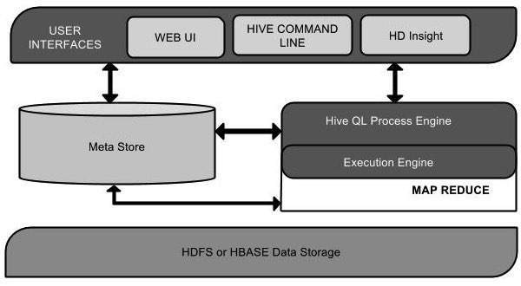
HIVE ARCHITECTURE

Slide 27
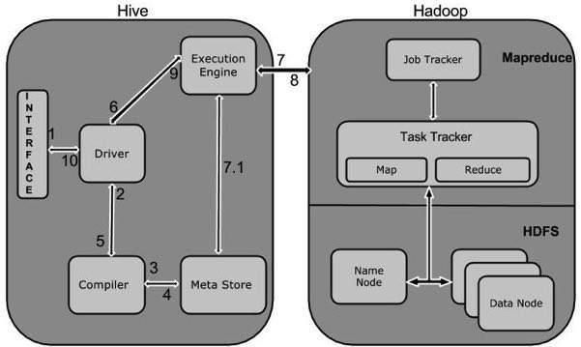
HIVE WORKFLOW

Slide 28
PIG
A scripting platform for processing and analyzing large data sets
Apache Pig allows to write complex MapReduce programs using a simple scripting language.
High level language: Pig Latin
Pig Latin is data flow language.
Pig translate Pig Latin script into MapReduce to execute within Hadoop.
Open source project
Developed by Yahoo

Slide 29
FEATURES OF PIG
Handles all kinds of data
UDF’s : User-defined Functionsin
Extensibility
Optimization opportunities
Ease of programming
Rich set of operators

Slide 30
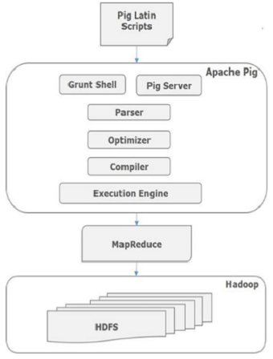
PIG ARCHITECTURE

Slide 31
PIG | SQL
Pig Latin is a procedural language. | SQL is a declarative language.
In Apache Pig, schema is optional. We can store data without designing a schema (values are stored as $01, $02 etc.) | Schema is mandatory in SQL.
The data model in Apache Pig is nested relational. | The data model used in SQL is flat relational.
Apache Pig provides limited opportunity for Query optimization. | There is more opportunity for query optimization in SQL.

Slide 32
PIG Vs HIVE
PIG | HIVE
Procedural Data Flow Language | Declarative SQLish Language
For Programming | For creating reports
Mainly used by Researchers and Programmers | Mainly used by Data Analysts
Operates on the client side of a cluster. | Operates on the server side of a cluster.
Does not have a dedicated metadata database. | Makes use of exact variation of dedicated SQL DDL language by defining tables beforehand.
Pig is SQL like but varies to a great extent. | Directly leverages SQL and is easy to learn for database experts.
Pig supports Avro file format. | Hive does not support it.

Slide 33
YARN
Yet Another Resource Manager takes programming to the next level beyond Java , and makes it interactive to let another application Hbase, Spark etc. to work on it.
Different Yarn applications can co-exist on the same cluster so MapReduce, Hbase, Spark all can run at the same time bringing great benefits for manageability and cluster utilization.

Slide 34
YARN
Components Of YARN
Map Reduce Application Master
Client
Resource Manager
Node Manager

Slide 35
BENEFITS OF YARN
Multitenancy
Utiliazation
Scalability

Slide 36
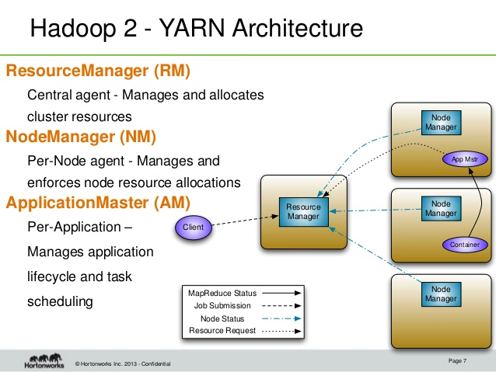
ARCHITECTURE OF YARN

Slide 37
SQOOP
Command-line interface for transforming data between relational database and Hadoop
Support incremental imports
Imports use to populate tables in Hadoop
Exports use to put data from Hadoop into relational database such as SQL server
It is used to import data from relational databases such as MySQL, Oracle to Hadoop HDFS, and export from Hadoop file system to relational databases.
Sqoop: “SQL to Hadoop and Hadoop to SQL”

Slide 38
SQOOP WORKFLOW
The dataset being transferred is broken into small blocks.
Map only job is launched.
Individual mapper is responsible for transferring a block of the dataset.

Slide 39
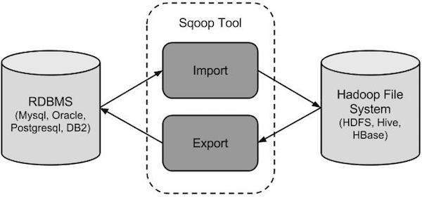
SQOOP ARCHITECTURE

Slide 40
Sqoop Import
The import tool imports individual tables from RDBMS to HDFS.
Each row in a table is treated as a record in HDFS.
All records are stored as text data in text files or as binary data in Avro and Sequence files.
Sqoop Export
The export tool exports a set of files from HDFS back to an RDBMS.
The files given as input to Sqoop contain records, which are called as rows in table.
Those are read and parsed into a set of records and delimited with user-specified delimiter.

Slide 41
FLUME
Apache Flume is a distributed, reliable, and available service for efficiently collecting, aggregating, and moving large amounts of streaming data into the Hadoop Distributed File System HDFS
Applications of Flume
Flume is used to move the log data generated by application servers into HDFS at a higher speed.

Slide 42
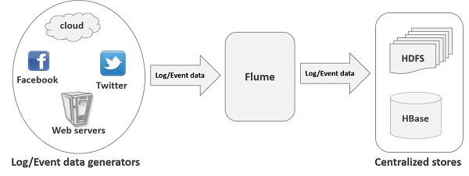
FLUME ARCHITECTURE

Slide 43
ADVANTAGES OF FLUME
Using Apache Flume we can store the data in to any of the centralized stores (HBase, HDFS).
The transactions in Flume are channel-based where two transactions (one sender and one receiver)
Flume is reliable, fault tolerant, scalable, manageable, and customizable
Flume provides the feature of contextual routing

Slide 44
FEATURES OF FLUME
Using Flume, we can get the data from multiple servers immediately into Hadoop.
Flume ingests log data from multiple web servers into a centralized store (HDFS, HBase) efficiently.
Along with the log files, Flume is also used to import huge volumes of event data produced by social networking sites like Facebook and Twitter, and e-commerce websites like Amazon and Flipkart.
Flume supports a large set of sources and destinations types.
Flume supports multi-hop flows, fan-in fan-out flows, contextual routing, etc.
Flume can be scaled horizontally.

Slide 45
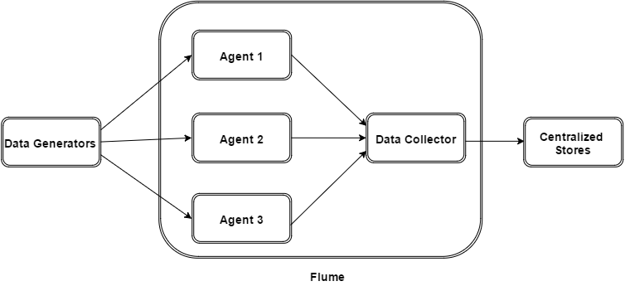
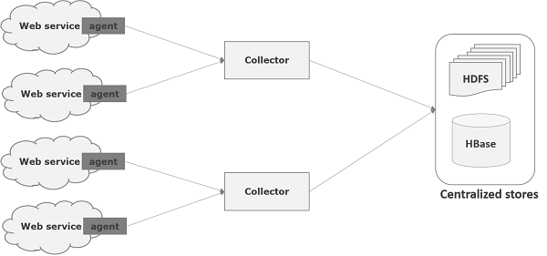

Slide 46
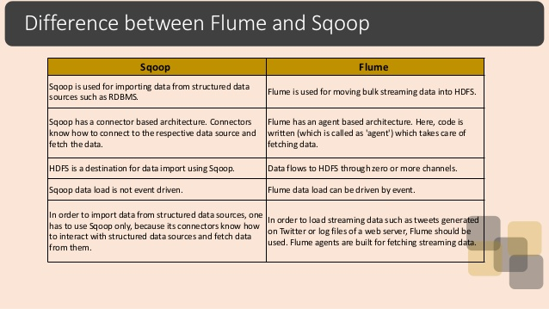

Slide 47
HBASE
HBase is a distributed column-oriented database built on top of the Hadoop file system.
It is an open-source project and is horizontally scalable.
HBase is a data model that is similar to Google’s big table designed to provide quick random access to huge amounts of structured data.
It is a part of the Hadoop ecosystem that provides random real-time read/write access to data in the Hadoop File System.
One can store the data in HDFS either directly or through HBase.
HBase sits on top of the Hadoop File System and provides read and write access.

Slide 48
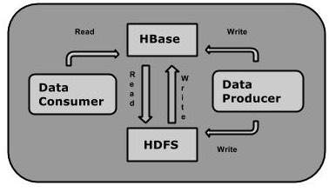
ARCHITECTURE OF HBASE

Slide 49
HBASE Vs HDFS
HDFS | HBase
HDFS is a distributed file system suitable for storing large files. | HBase is a database built on top of the HDFS.
HDFS does not support fast individual record lookups. | HBase provides fast lookups for larger tables.
It provides high latency batch processing; no concept of batch processing. | It provides low latency access to single rows from billions of records (Random access).
It provides only sequential access of data. | HBase internally uses Hash tables and provides random access, and it stores the data in indexed HDFS files for faster lookups.

Slide 50
FEATURES OF HBASE
HBase is linearly scalable.
It has automatic failure support.
It provides consistent read and writes.
It integrates with Hadoop, both as a source and a destination.
It has easy java API for client.
It provides data replication across clusters.

Slide 51
ZOOKEEPER
ZooKeeper is a distributed co-ordination service to manage large set of hosts.
Co-ordinating and managing a service in a distributed environment is a complicated process.
ZooKeeper solves this issue with its simple architecture and API.
ZooKeeper allows developers to focus on core application logic without worrying about the distributed nature of the application.
The ZooKeeper framework was originally built at “Yahoo!” for accessing their applications in an easy and robust manner.
Later, Apache ZooKeeper became a standard for organized service used by Hadoop, HBase, and other distributed frameworks.

Slide 52
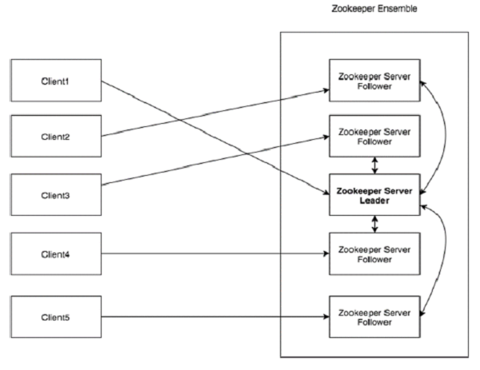
ARCHITECTURE

Slide 53
ZOOKEEPER SERVICES
Naming service
Configuration management
Cluster management
Leader election
Locking and synchronization service
Highly reliable data registry

Slide 54
BENEFITS OF ZOOKEEPER
Simple distributed coordination process
Synchronization
Ordered Messages
Serialization
Atomicity
Reliability

Slide 55
OOZIE
Apache Oozie is a scheduler system to run and manage Hadoop jobs in a distributed environment.
It allows to combine multiple complex jobs to be run in a sequential order to achieve a bigger task.
One of the main advantages of Oozie is that it is tightly integrated with Hadoop stack supporting various Hadoop jobs like Hive, Pig, Sqoop as well as system-specific jobs like Java and Shell.
Oozie detects completion of tasks through callback and polling.
Oozie is an Open Source Java Web-Application available under Apache license 2.0.
It is responsible for triggering the workflow actions, which in turn uses the Hadoop execution engine to actually execute the task.

Slide 56
OOZIE JOBS
Oozie Bundle
Oozie Coordinator Jobs
Oozie Workflow Jobs

Slide 57
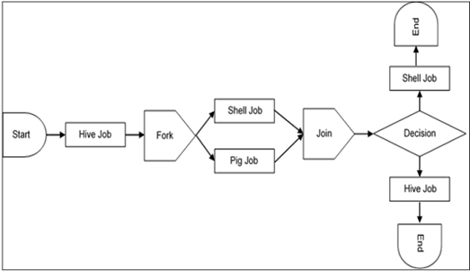
ARCHITECTURE OF OOZIE

Slide 58
SPARK
Apache Spark is a lightning-fast cluster computing technology, designed for fast computation.
It is based on Hadoop MapReduce and it extends the MapReduce model to efficiently use it for more types of computations, which includes interactive queries and stream processing.
The main feature of Spark is its in-memory cluster computing that increases the processing speed of an application.
Spark is designed to cover a wide range of workloads such as batch applications, iterative algorithms, interactive queries and streaming.
Apart from this, it reduces the management burden of maintaining separate tools.

Slide 59
FEATURES
Advanced Analytics
Supports multiple languages
Speed

Slide 60
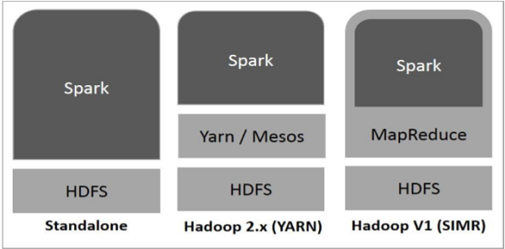
ARCHITECTURE OF SPARK

Slide 61
CASSENDRA
Apache Cassandra is an open source, distributed and decentralized/distributed storage system (database), for managing very large amounts of structured data spread out across the world.
Its distribution design is based on Amazon’s Dynamo and its data model on Google’s Bigtable.
It is scalable, fault-tolerant, and consistent
It is a column-oriented database
It provides highly available service with no single point of failure.

Slide 62
FEATURES
Elastic scalability
Fast writes
Fast linear-scale performance
Flexible data storage
Easy data distribution
Transaction support
Always on architecture

Slide 63
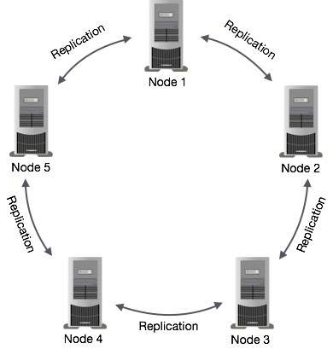
ARCHITECTURE

Slide 64
GRAPH

Slide 65
GRAPH

Slide 66
TABLES
YEAR | CERTIFIED-WITHDRAWN | WITHDRAWN | CERTIFIED | DENIED | H1B VISA APPLICATIONS
2011 | 11596 | 10105 | 307936 | 29130 | 358767
2012 | 31118 | 10725 | 352668 | 21096 | 415607
2013 | 35432 | 11590 | 382951 | 12141 | 442114
2014 | 36350 | 16034 | 455144 | 11899 | 519427
2015 | 41071 | 19455 | 547278 | 10923 | 618727
2016 | 47092 | 21890 | 569646 | 9175 | 647803

Slide 67
TABLES
YEAR | CERTIFIED- WITHDRAWN | WITHDRAWN | CERTIFIED | DENIED | TOTAL
2011 | 3.232181332 | 2.81659127 | 85.83175153 | 8.119476 | 100
2012 | 7.487361859 | 2.580562888 | 84.8561261 | 5.075949 | 100
2013 | 8.014222576 | 2.621495813 | 86.61815731 | 2.746124 | 100
2014 | 6.998095979 | 3.086863024 | 87.62424749 | 2.290794 | 100
2015 | 6.637984119 | 3.144359305 | 88.45225762 | 1.765399 | 100
2016 | 7.269493967 | 3.379113712 | 87.93506668 | 1.416326 | 100

